Slide 1

Sheepshead
Farm to Desktop
Spring 2016
David Goldstein
Computer Science Capstone Presentation

Slide 2
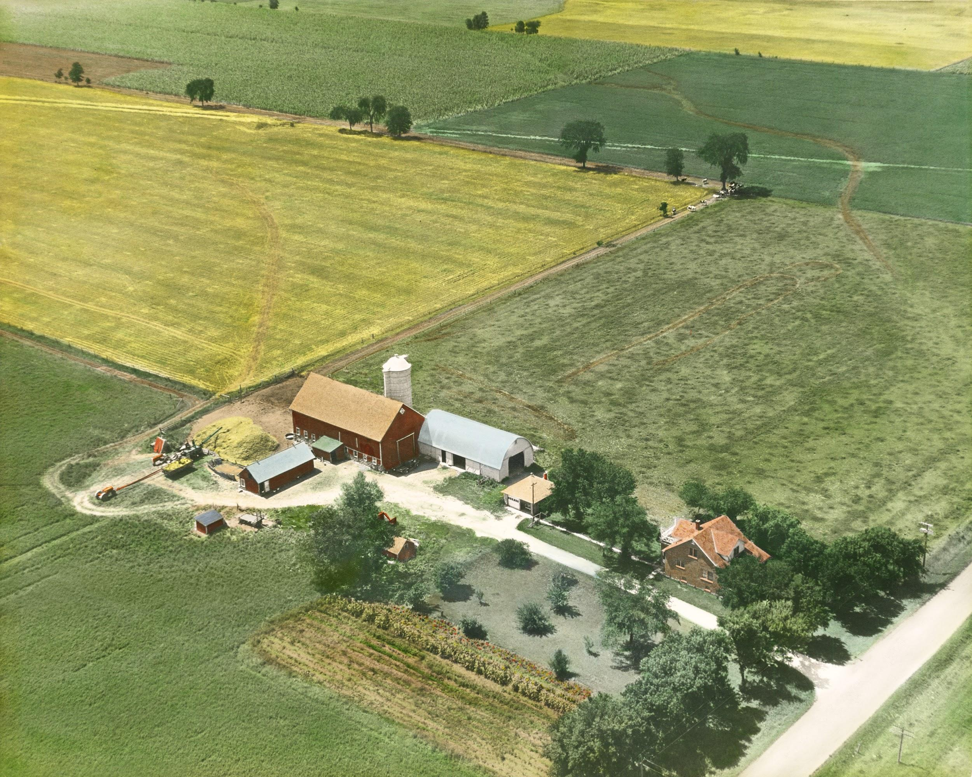
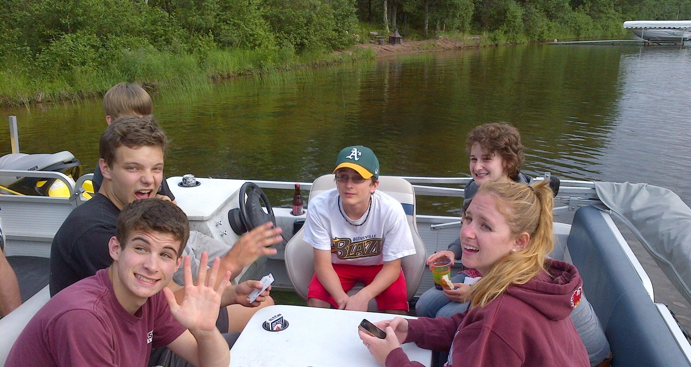
Origins
Notes:
Picking up
Burying
Partner / playing alone

Slide 3
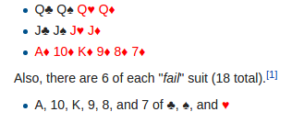
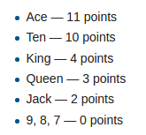
Rules
Strength Points
Notes:
Picking up
Burying
Partner / playing alone

Slide 4
Demo

Slide 5
Development

Slide 6
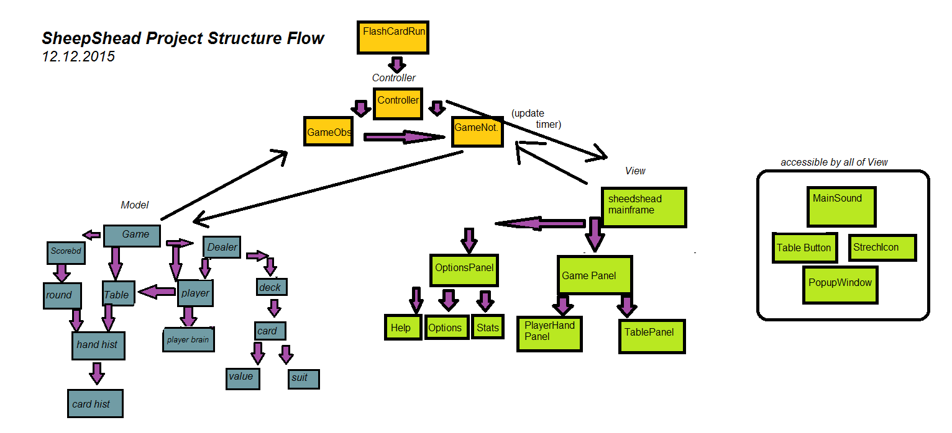
Notes:
Picking up
Burying
Partner / playing alone

Slide 7
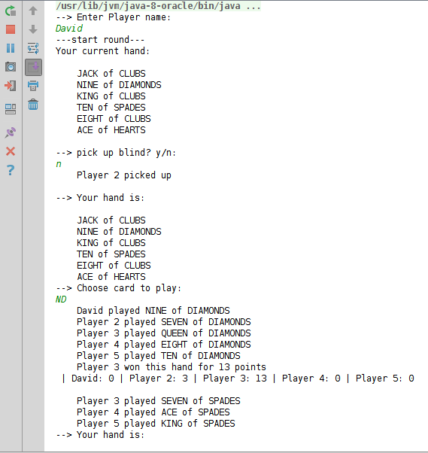
Game Rules (2 weeks)
Notes:
Picking up
Burying
Partner / playing alone

Slide 8
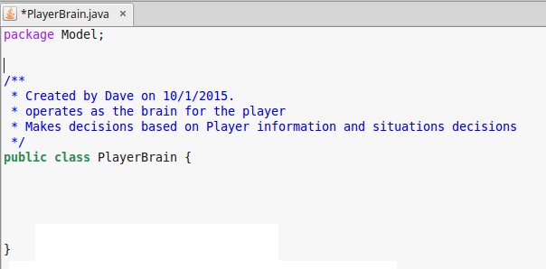
2. AI Players (6 weeks)
Notes:
Picking up
Burying
Partner / playing alone

Slide 9
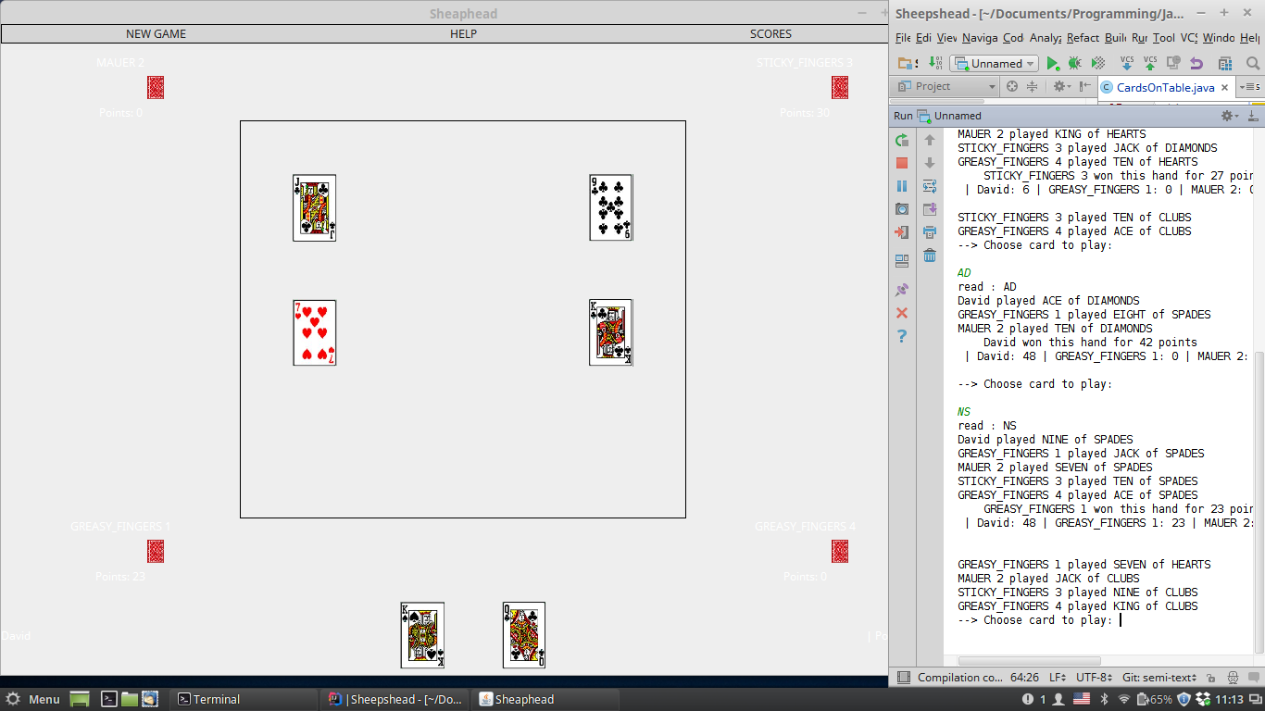
3. User Interface (4 weeks)
Notes:
Picking up
Burying
Partner / playing alone

Slide 10
AI

Slide 11
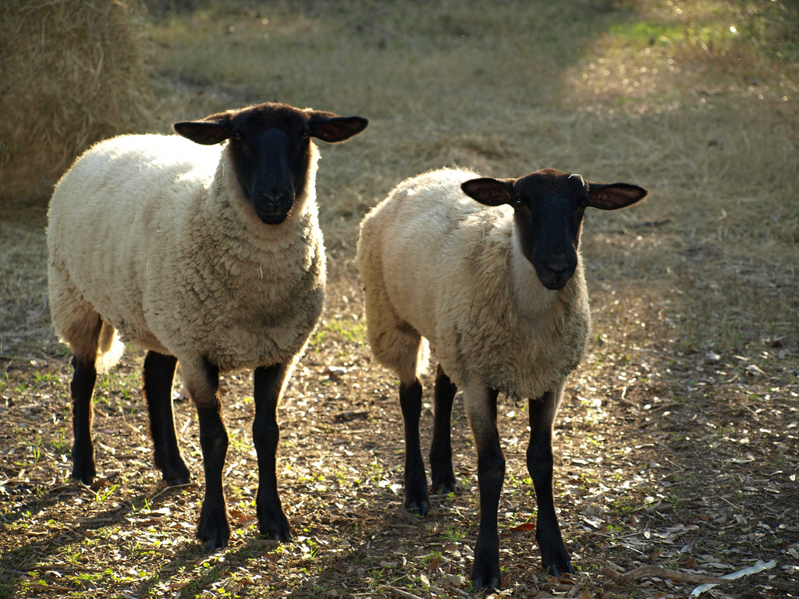
AI Decision Making
Play Alone
Pick up

Slide 12
Play Alone
Suppose...

Slide 13
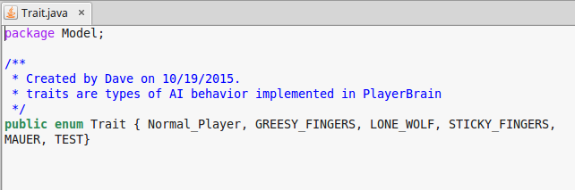
Traits

Slide 14
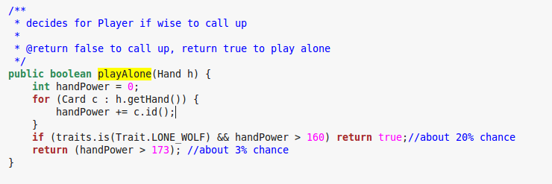
Implementation!

Slide 15
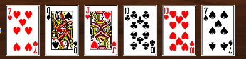
2. Pick Up?
Great Hand:
But suppose..

Slide 16
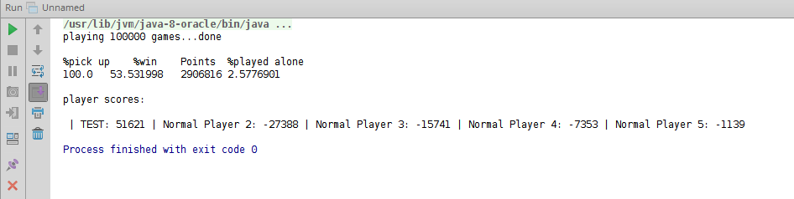
Test Environment

Slide 17
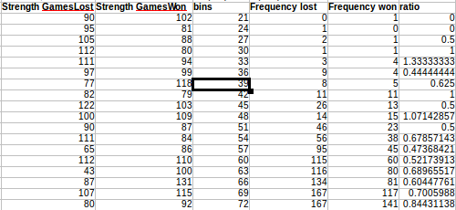
Data!

Slide 18
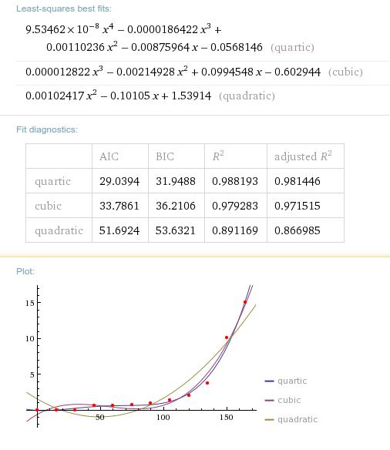
Regression!

Slide 19
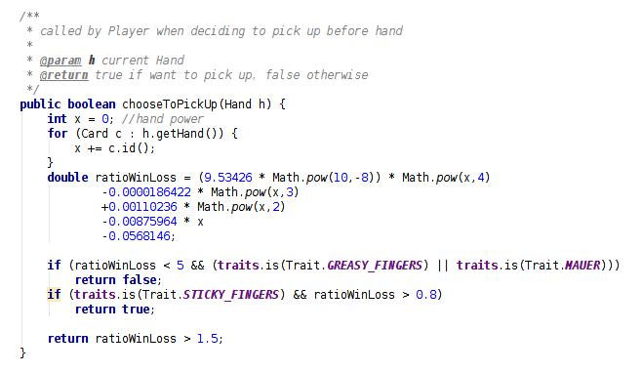
Implementation!
Pick Up

Slide 20
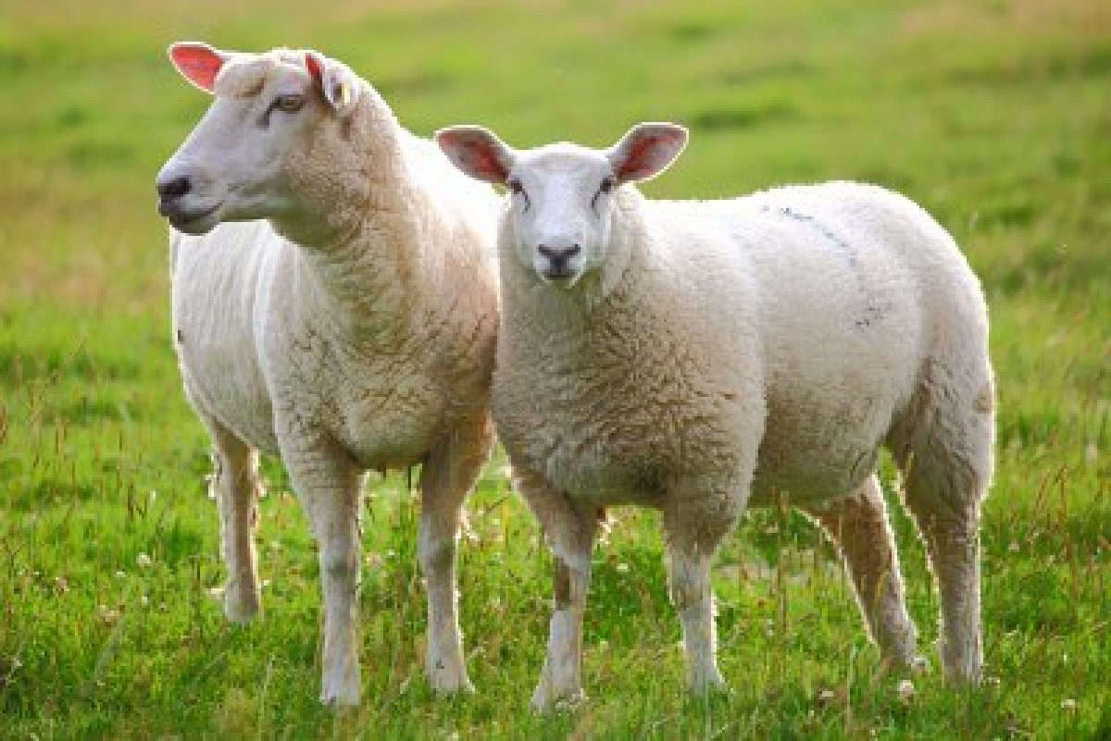
Extras!!
Debugger
Stats
Rules

Slide 21

Possible Next Steps?
AI Machine Learning / Adaptation
Multiplayer

Slide 22

Thank you!
Questions / Comments?

